Slide 1

教学辅助课件
牛津 七年级下

Slide 2


Unit 7 Abilities
Study skills

Slide 3


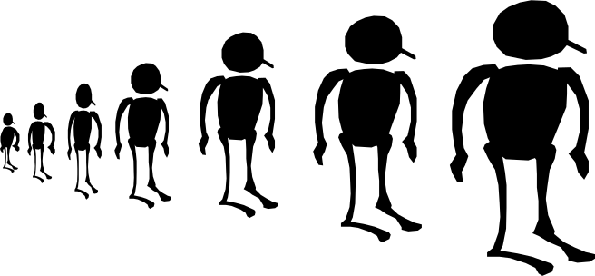
Objectives
To be able to look for information in a library
To know how to classify libraries according to different topics

Slide 4

What are you interested in?
P.E.
Maths
History
Literature
Science
…

Slide 5


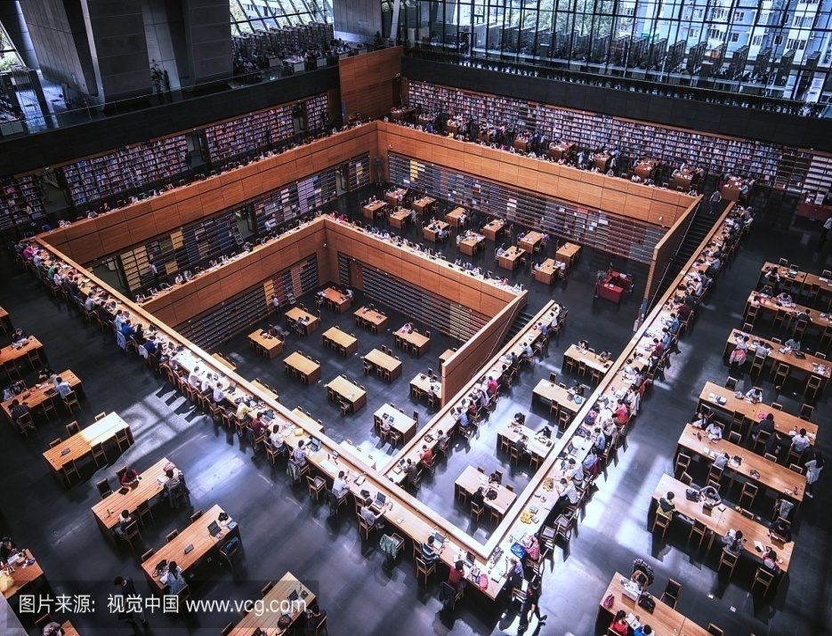

If you want to learn more about your favorite subject, what can you do?
Welcome to Sunshine Town!
Library
might be a good choice.

Slide 6



How to use a library?
Books about different
subjects are put in
different sections.
1
  Books are organized according to topics. Books about similar
  topics are put in the same area.
2

Slide 7

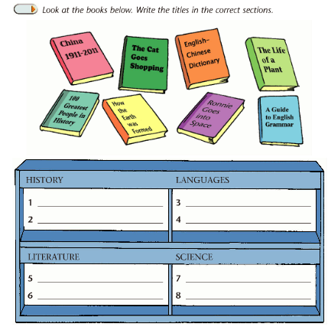
Look at the books below. Write the titles in the correct sections.
China 1911-2011
English-Chinese Dictionary
100 Greatest People in History
A Guide to English Grammar
The Cat Goes Shopping
The Life of a Plant
Ronnie Goes into Space
How the Earth was Formed
Notes:
Let’s check the sections… The Cat Goes Shopping and Ronnie Goes into Space are novels. Do you like reading novels? For example, Harry Potter. Its author, that is its writer, is J. K. Rowling.

Slide 8





Novels are arranged in
alphabetical order according
to the authors’ surnames.
3
Margaret Mitchell
Ernest Hemingway
J.K. Rowling
Charlotte Brontë
3
2
4
1

Slide 9

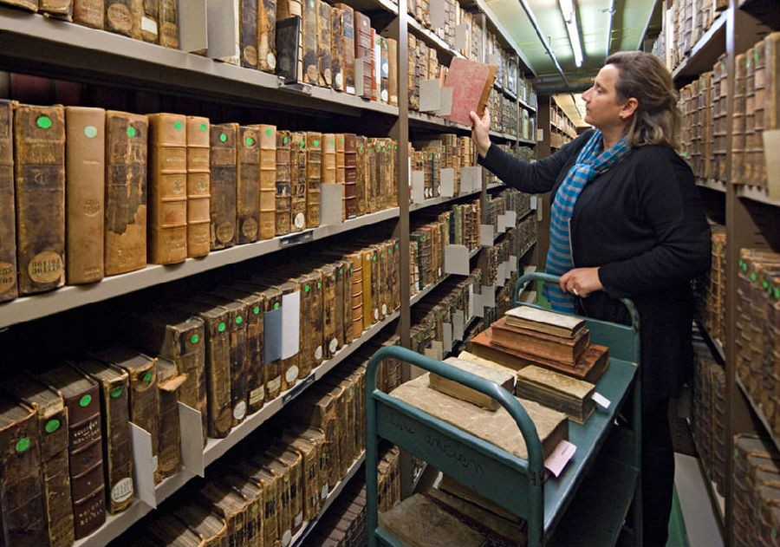
She works in the library. She is a librarian
Librarians are there to help
you. If you have any questions,
ask them.
4

Slide 10
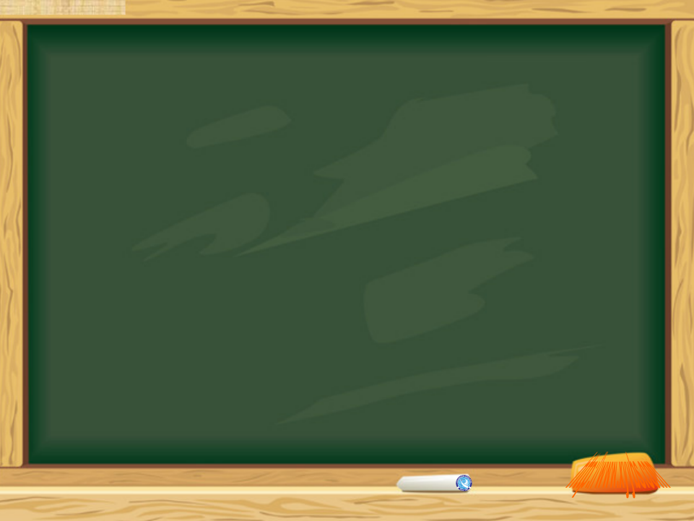

1. Read the sentences on page 90.
2. Preview Task on P40.

